Slide 1

Exploring Neural Approaches for
Tiny Story Generation
DATS-6312: Natural Language Processing for Data Science
Instructor: Prof. Amir Hossein Jafari
Team Members:
Abhilasha Singh
Pranjal Wakpaijan
Shabnam Rafat Ummey Sawda

Slide 2
Our Agenda Today
01
Background & Project Goals
02
03
Exploratory Data Analysis (EDA)
Dataset Description
06
Key Findings
05
Explored Architectures
04
Evaluation Metrics
07
Challenges & Limitations
08
Conclusion
09
Demo

Slide 3
Background
Story generation is challenging problem in NLP – Requires meaningful sequence of events that feels coherent and stays consistent with characters and themes. – Requires understanding long-range relationships in the text – Integrate user constraints (keywords + starting prompt)
Project Goals
Generate coherent stories from a prompt/ keywords using multiple neural models.
Performance evaluation on the models for story generation

Slide 4
Data Description
Tiny Stories Dataset (Hugging Face)
~2.14M stories
Contains story, instruction (prompt, required words, features, summary),source
Subset Used
-50 JSON files merged → cleaned → filtered
-Final split: • Train: 79,192 samples • Validation: 9,899 samples • Test: 9,899 samples

Slide 5
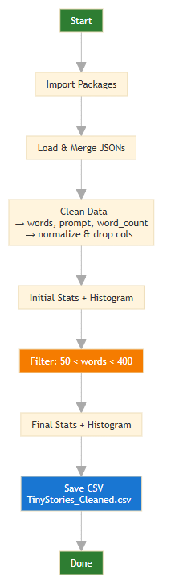
Exploratory Data Analysis(EDA)
Loading and Initial Inspection of Data
Extracting Keywords and Prompts
Removing Irrelevant Metadata fields and Validating Data Quality
Normalizing Text for Model Compatibility
Visualized and calculated word counts for filtering and analysis

Slide 6
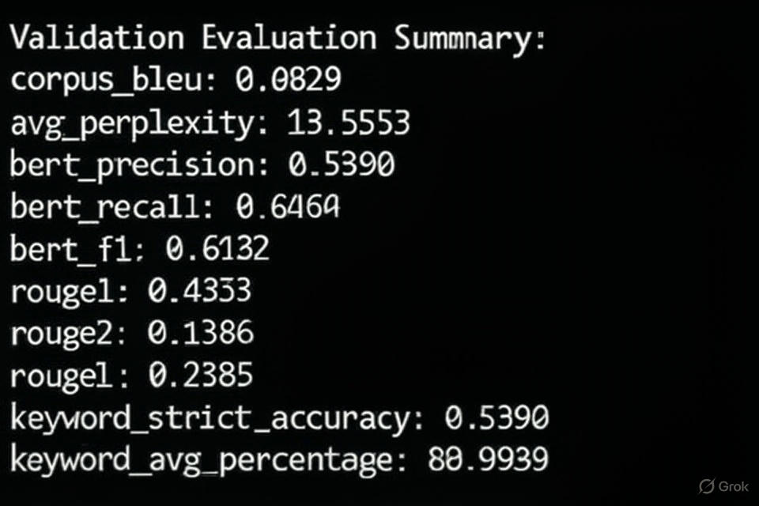
Evaluation Metrics
BLEU -Match Words
Perplexity-Prediction difficulty
BERT Score -Semantic Similarity
ROUGE Scores-Overlap Check
Keyword-based Metrics -Keyword Matching

Slide 7
Explored Architectures
Baseline Model: GPT-2 Causal Language Model
Token Embedding → Transformer Decoder Layers → Next-Token Prediction
LSTM–Attention Seq2Seq Model
LSTM Encoder → Attention → LSTM Decoder
Flan-t5
Transformer Encoder → Cross-Attention → Transformer Decoder
GNN-Retrieval+SLM
Graph Neural Network → Graph Embeddings → Small Language Model Decoder
LLM
LLM + LoRA

Slide 8
Baseline Model:
GPT-2 Causal Language Model
Training Setup:​
Max length: 192 tokens​
Epochs: 5​
Batch size: 2​
Optimizer: Adam (3e-5)​
Best model saved by validation loss
Model Type: GPT-2 (decoder-only transformer)
Task: Story generation from prompt + keywords
Tokenizer: GPT-2 BPE
Pipeline: Data → Prompt Formatting → Tokenization → GPT-2 Training → Story Generation → Evaluation
Generation (Inference)
Build prompt without gold story
Sampling:
Temperature: 0.6
Top-p: 0.95
Repetition penalty: 1.2
Generate 256 new tokens

Slide 9
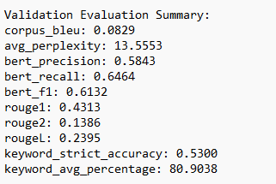
Performance of Baseline GPT-2 Model
Overall:
GPT-2 generates fluent stories but lacks precise control over content and keyword alignment.

Slide 10
LSTM–Attention Seq2Seq Model
Training Setup:​
Max encoder length: 128 tokens
Max decoder length: 192 tokens
Epochs: 5
Batch size: 16
Optimizer: Adam (3e-4)
Loss: Cross-Entropy (ignore PAD)
Gradient clipping: 1.0
Best model saved by validation loss
Model Type: LSTM Encoder → Bahdanau Attention → LSTM Decoder (Seq2Seq)
Task: Story generation from prompt + keywords
Tokenizer: GPT-2 BPE tokenizer
Pipeline: Data → Prompt/Story Split → Tokenization → LSTM Encoder → Attention + LSTM Decoder → Train → Generate → Evaluate
Generation (Inference)
Build prompt without gold story
Apply Bahdanau Attention
Use greedy decoding with attention
Start with BOS until EOS or max length

Slide 11
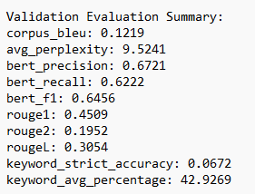
Performance of LSTM–Attention Seq2Seq Model
Overall:
The LSTM–Attention model shows better fluency and lexical overlap than GPT-2, but continues to struggle with precise keyword incorporation, limiting its controllability despite stronger sequence modeling.

Slide 12
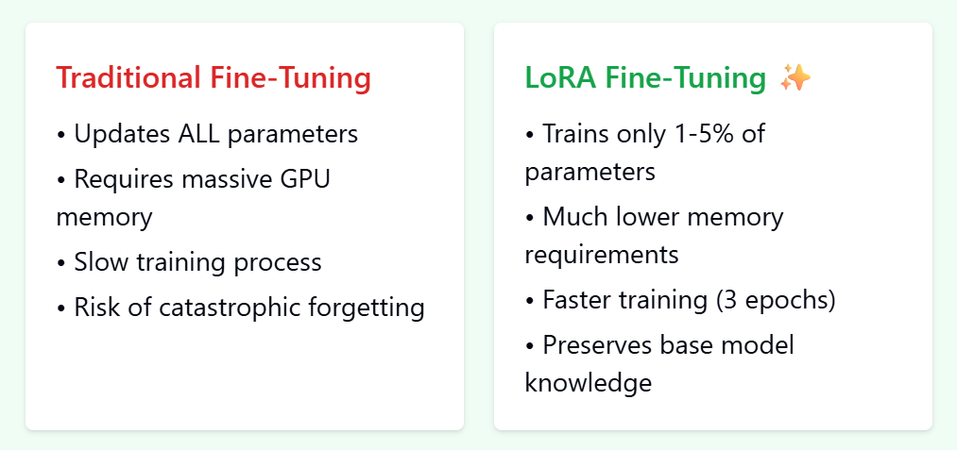
Flan T5
Foundation: Built upon the T5 (Text-to-Text Transfer Transformer) architecture.
Architecture: Uses a standard Encoder-Decoder structure, which is ideal for sequence-to-sequence tasks like summarization, translation, and generation.
Generalization: Excels at zero-shot and few-shot generalization—it can follow instructions for tasks it has never seen before.
Developer: Developed by Google.
Why Fine-Tune using LoRA

Slide 13
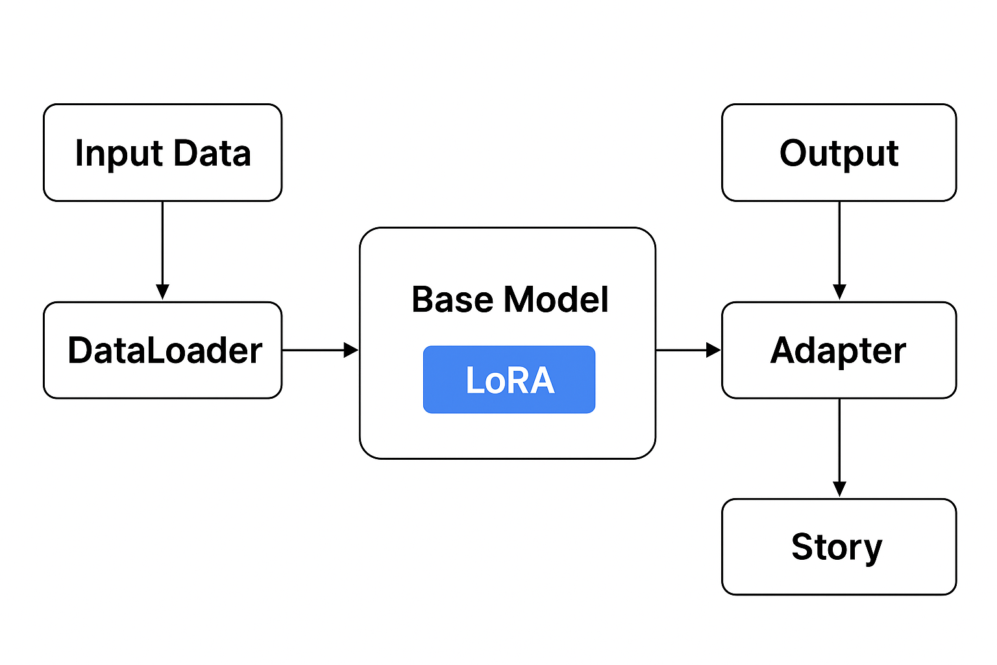
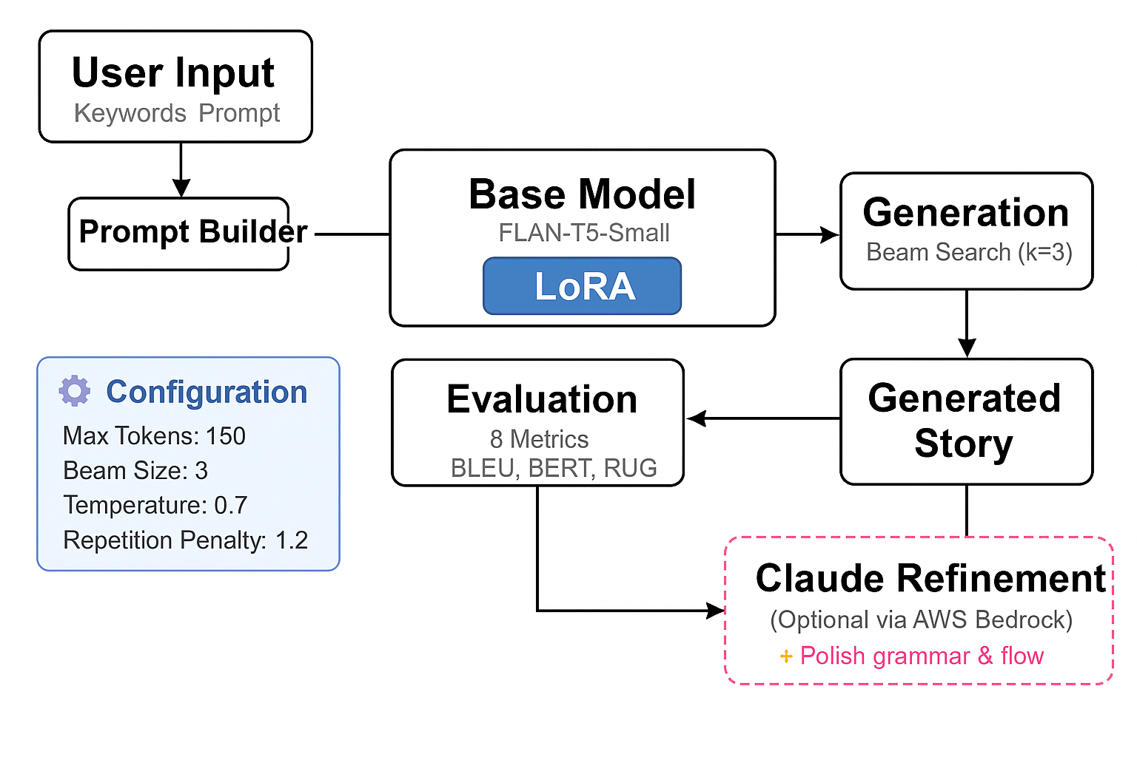

Model Architecture
Training
Inference

Slide 14
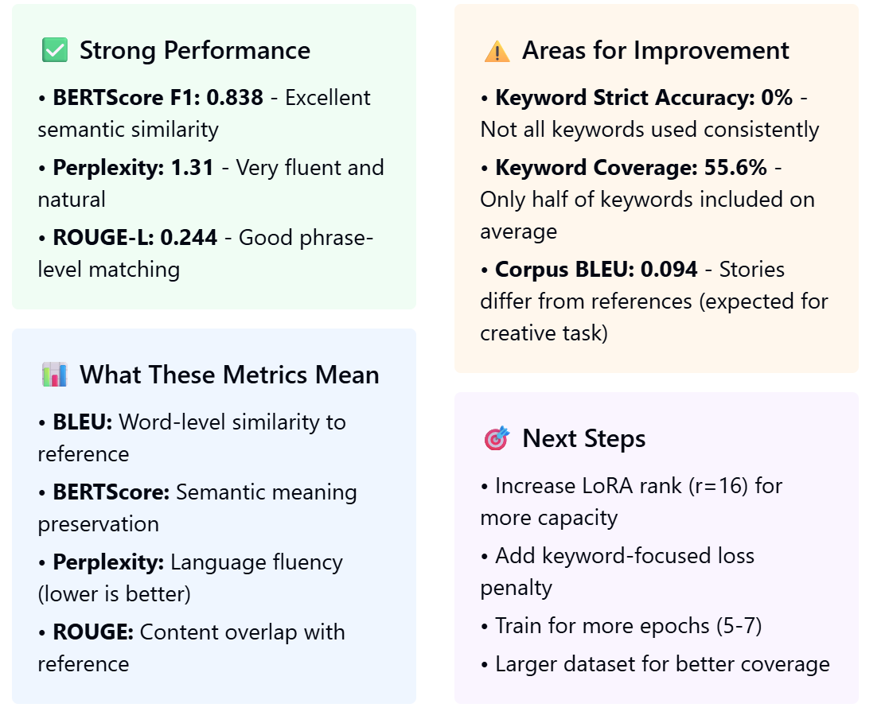
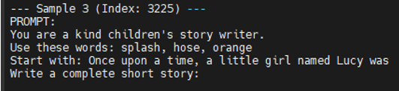
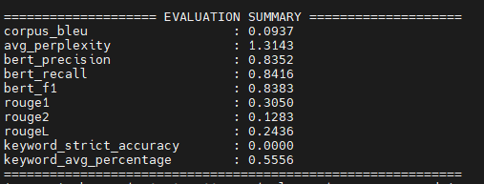
Results
Example Prompt

Slide 15
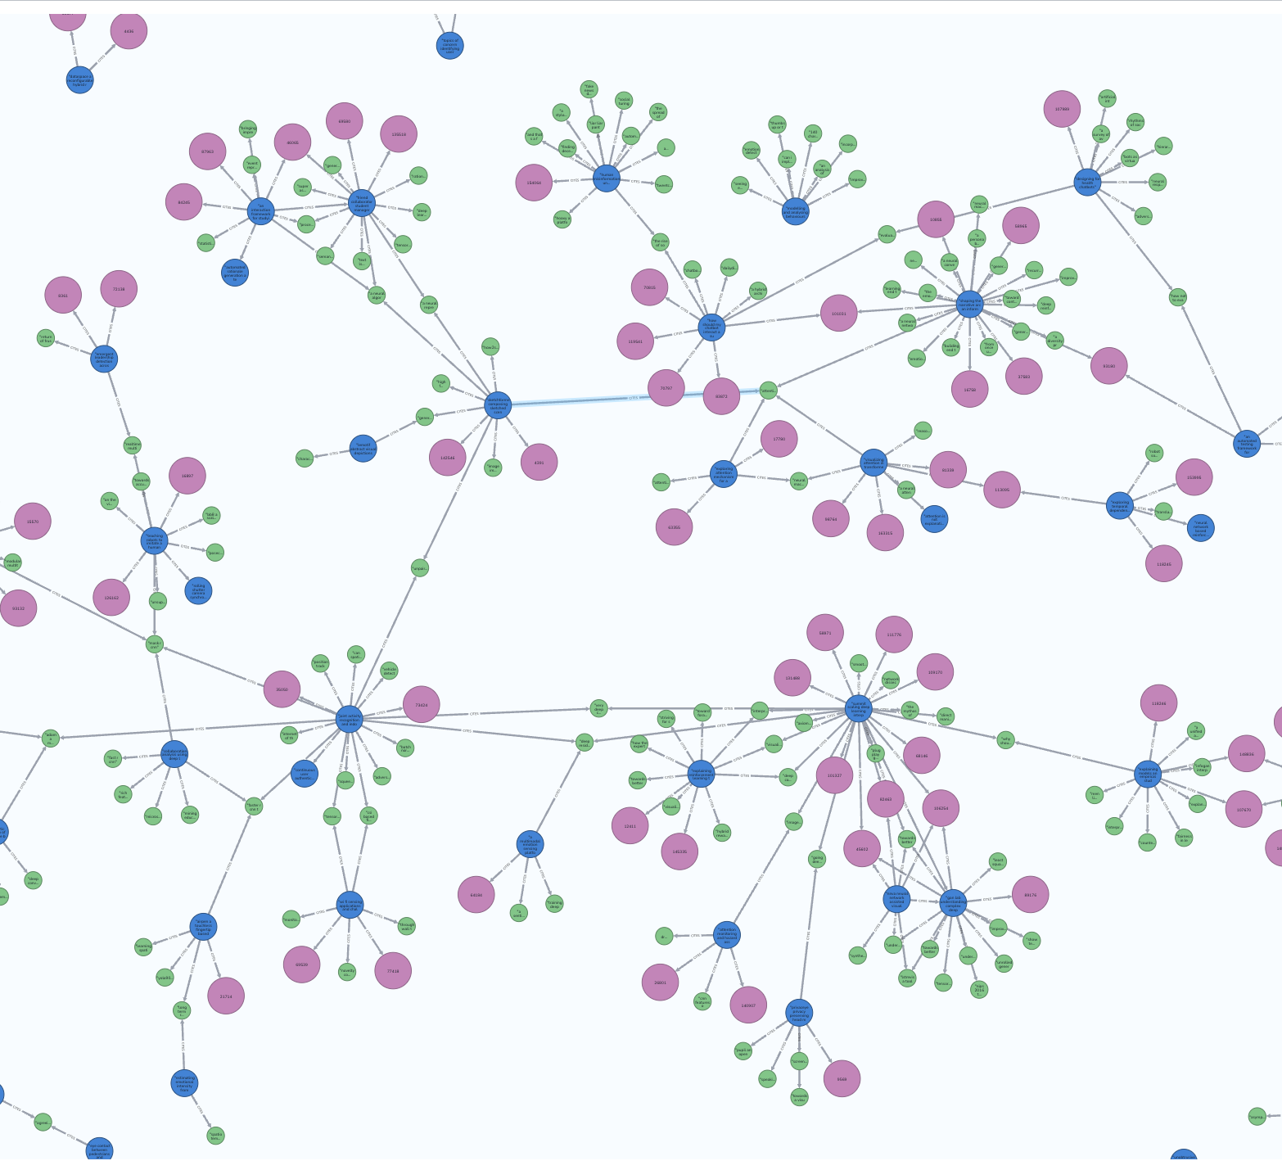
GNN-Retrieval + SLM
Purpose:
To evaluate whether adding a GNN-retrieval module to a SLM improves story-generation performance compared to its SLM-only baseline
GNN-Retrieval
Combines graph reasoning with example retrieval to provide structured and context-rich guidance before text generation.
SLM
A compact language model that generates text autoregressively from a provided prompt.

Slide 16
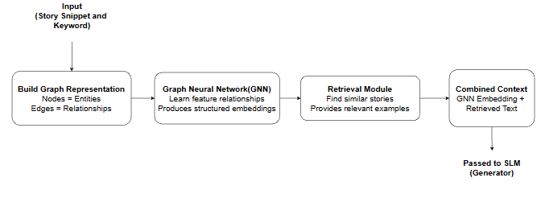
Graph Neural Network(GNN)
With Retrieval Strategy
A GNN (Graph Neural Network) is a model that learns from nodes and connections instead of plain text.
It understands relationships between features
It creates a structured embedding that summarizes how everything is connected.
Why we picked this model to our task?
Because it lets us add structured relational information on top of the language model to guide better story generation.
Specifications:
01
Captures Relationships
Helps the model understand how keywords or concepts relate to each other.
02
Adds structured context
Provides the generator with a clearer map of what should appear in the text.
03
Improves relevance
What retrieval strategy does?
Gives the language model a stronger conditioning signal, so generated text stays on-topic.
The retrieval strategy finds and provides the most relevant past examples to guide the model during generation

Slide 17
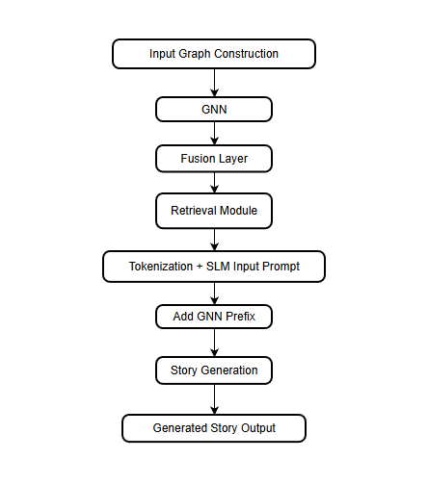
Design Approach
Component Block
Functionalities
01
Input Graph Construction
Builds a graph from keywords and entities, capturing how important story elements are connected.
02
GNN
Learns relationships between graph features and produces a structured embedding summarizing the entire graph.
03
Fusion Layer
Maps the GNN embedding into the language model’s embedding space and prepares prefix tokens.
04
Retrieval Module
Finds the most relevant stories from the training set and provides additional reference context.
05
Tokenization + SLM Input Prompt
Converts text into tokens and forms the prompt that the story generation model will follow.
07
Add GNN Prefix
Injects GNN-derived soft prompt vectors before the textual prompt to guide the language model.
08
Story Generation
Uses the combined context (prefix + prompt + retrieved examples) to generate the full story.
09
Generated Story Output
Produces the final generated story as model output.

Slide 18
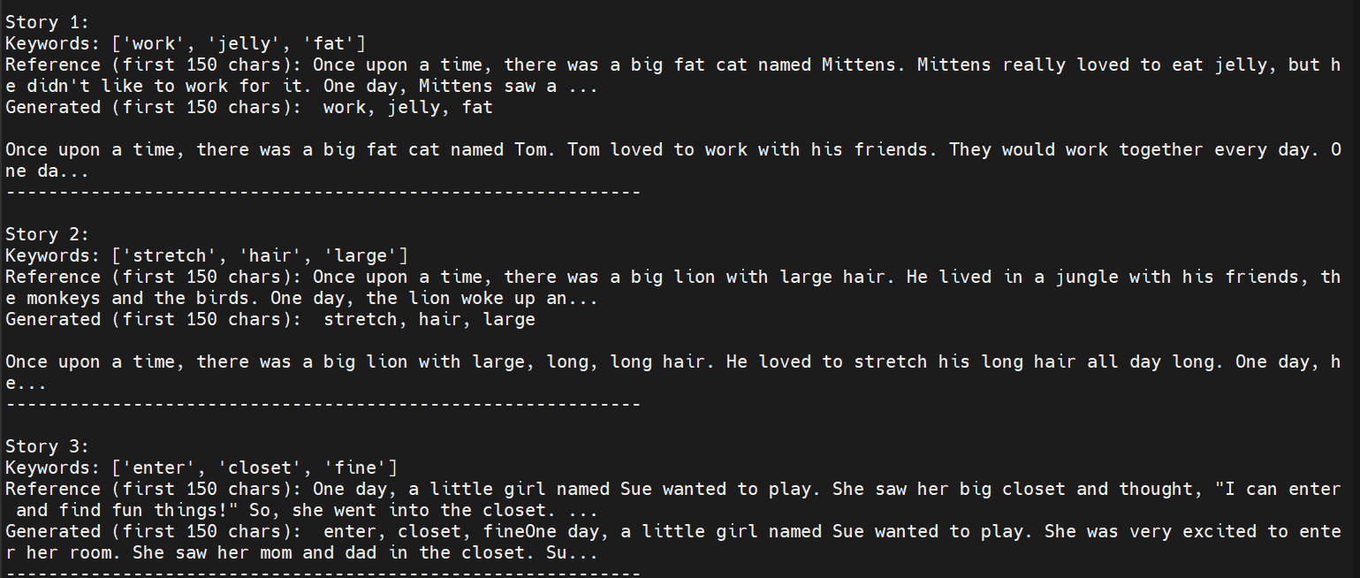
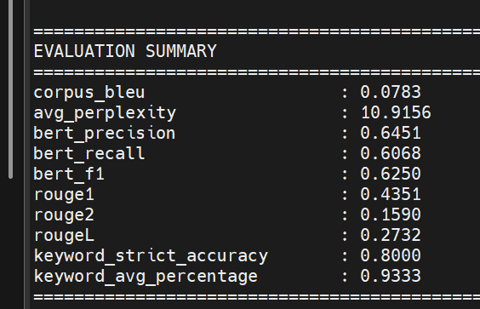
Training Setup and Evaluation
Model configuration
Training hyperparameters
Base LM (SLM): GPT-2
GNN encoder:
Node feature dim = 390
Hidden dim = 256
3 GNN layers, 4 heads
Prefix fusion: Linear layer projecting GNN embedding → 16 prefix tokens in LM hidden space
Retrieval module: k = 3 nearest stories
Optimizer: AdamW
Learning rate: 5 × 10⁻⁵
Weight decay: 0.01
Batch size (GPU): 4 graphs
Max epochs: 10 (with early stopping patience = 5 epochs)
Gradient clipping: max_norm = 0.5
LR scheduler: linear warmup 10% of steps + cosine decay
Key Findings:
Next Steps(Quick Wins):
BLEU and ROUGE scores remain low, showing limited alignment with reference stories despite added graph structure.
Perplexity is still high, indicating the combined model did not reduce uncertainty in next-token prediction.
BERTScore shows moderate semantic similarity, but no improvement over simpler models like LSTM or SLM-only. without clear metric gains.
Increase k in retrieval (from 3 → 5 or 7) to provide richer reference context.
Adding graph structure and retrieval did not translate into measurable improvements in fluency or constraint satisfaction based on standard metrics.

Slide 19
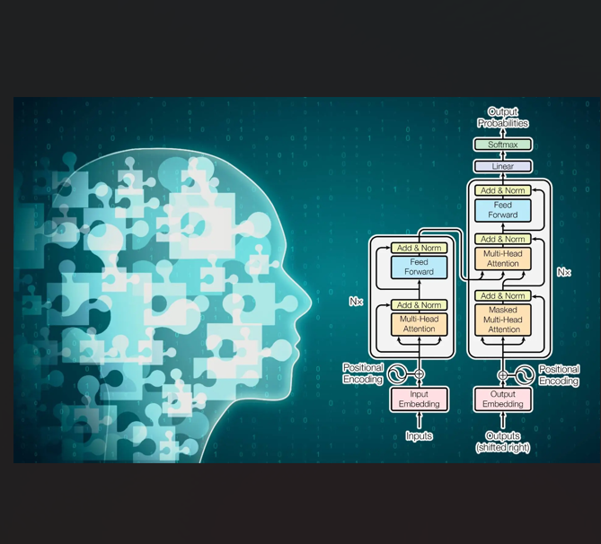
Open-Source LLM (Mistral-7B)
Purpose:
To train a standalone open-source LLM that generates stories directly from keyword-conditioned prompts using causal language modeling
LLM
Learns to generate full stories from prompts by fine-tuning a large language model (Mistral-7B) on the story dataset without any graph or retrieval components.

Slide 20
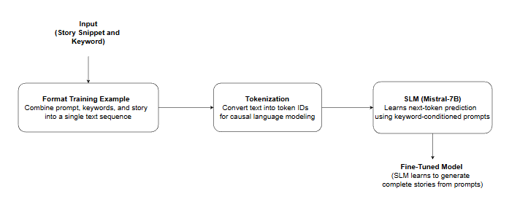
Large Language Model(LLM)
Fine-Tuned for Story Generation
It processes the formatted text, predicts the next tokens step-by-step, and generates a complete story without using any graph or retrieval information.
Why we picked this model to our task?
Because we wanted to test whether a stronger, better-tuned LLM (using LoRA and optimized formatting) can outperform the original GPT-2 benchmark without adding any external modules.
This allows us to measure: Does simply using a better language model improve story generation?
Specifications:
01
Learns Keyword-Conditioned Story Patterns
Understand the relationship between provided keywords and the story beginning, enabling it to continue the story meaningfully.
02
Enhanced Through LoRA Training
Let the model learn efficiently from the dataset while keeping training stable and lightweight.
LLM(Mistral-7B)
03
Serves as an Improved Baseline Variant
An open source LLM-only setting to check how much improvement comes purely from using a more capable generator.
(LLM learns to generate complete stories from prompts)

Slide 21
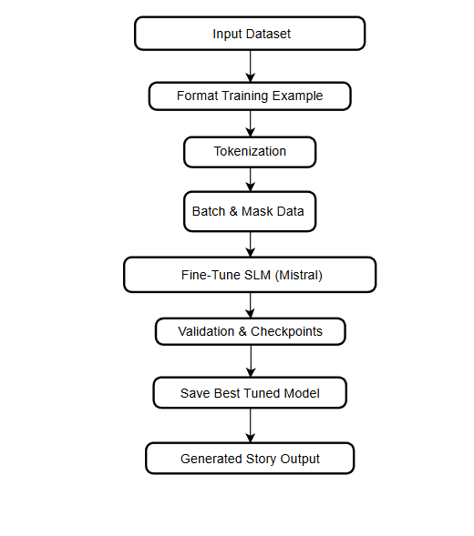
Design Approach
Component Block
Functionalities
01
Input Dataset
Loads the story, keywords, and story-beginning fields from the dataset to prepare examples for training.
02
Format Training Example
Combines the prompt, keywords, and full story into a single formatted text sequence for causal language modeling.
03
Tokenization
Converts formatted text into token IDs and attention masks that the language model can process.
04
Batch & Mask Data
Pads sequences, creates labels for next-token prediction, and applies masking so the model only learns from valid tokens.
Fine Tuned LLM(Mistral-7B)
Trains language model (with LoRA adapters) on formatted dataset so it learns to generate stories from keyword-conditioned prompts.
05
Fine-Tune LLM (Mistral)
07
Validation & Checkpoints
Evaluates the model after each epoch, tracks validation loss, and saves the best-performing checkpoint.
08
Save Best Tuned Model
Stores the final tuned model used for story generation and for performance comparison with other approaches
09
Generated Story Output
Produces the final generated story as model output.

Slide 22
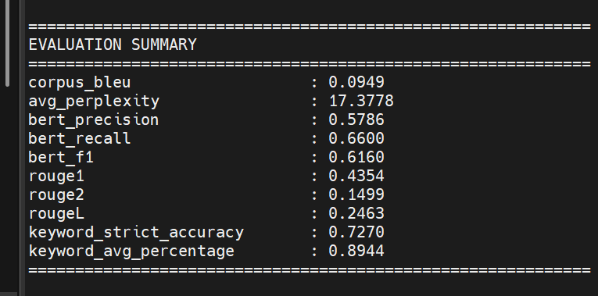
Training Setup and Evaluation
Model configuration
Training hyperparameters
LLM: Mistral-7B
Fine-tuning method: LoRA adapters
r = 16
α = 32
Tokenizer: Mistral tokenizer with EOS as padding token
Input format: Combined keywords + story beginning + full story as a single training sequence
Optimizer: AdamW
Learning rate: 2 × 10⁻⁴
Weight decay: 0.01
Batch size:
Train: 6
Validation: 4
Max epochs: 3
LoRA-enabled training: significantly reduces trainable parameters
Key Findings:
Next Steps(Quick Wins):
Keyword accuracy better than other approaches but still critically low (72% strict, 89% partial)
Story quality is decent but not exceptional
High perplexity (17.4) suggests uncertainty
ROUGE scores show weak lexical overlap
Increase training epochs from 3 to 10-15
Emphasize keywords in prompt
Increase keyword penalty weight
Lower temperature from 0.7 to 0.5
Mistral-7B with LoRA can generate coherent children's stories, but keyword constraint satisfaction needs improvement

Slide 23
Key Findings
No single model outperformed the others across all evaluation metrics.
LSTM showed competitive scores, especially in perplexity and semantic similarity.
LLM (Mistral-7B) did not show clear superiority in BLEU, ROUGE, BERTScore, or keyword accuracy.
Keyword adherence remained low across all models, indicating difficulty in enforcing constraints.
All models showed low ROUGE scores, reflecting limited overlap with reference stories.

Slide 24
Challenges & Limitations
Standard metrics used (BLEU, ROUGE, Perplexity) do not capture story coherence, flow, or creativity.
Models appeared similar in metrics even when story quality differed qualitatively.
No evaluation of narrative coherence, entity consistency, or plot structure.
Lack of advanced metrics (MAUVE, Entity Grid, Lexical Diversity, Story Cloze).
Human evaluation missing — limits interpretation of “story quality.”.

Slide 25
Conclusion
Metric-based results showed no clear model outperforming others across BLEU, ROUGE, or BERTScore.
LSTM remained a competitive baseline, often matching or surpassing larger models in standard metrics.
Story-generation quality requires more suitable evaluation metrics (MAUVE, coherence measures, diversity scores).
Overall, the study highlights the need for task-appropriate and human-centered evaluation to judge narrative generation systems.

Slide 26
DEMO

Slide 27

Question & Answer

Slide 28

Entropy
Enrtopy © 2024

